Slide 1



Predicting Tissue-Specific Gene Expression from Blood Using AI
Data Science Project Pt. 1 and 2 (MAST90106 & MAST90107)
The University of Melbourne
Presented by
Kartika Waluyo, 1000555
Vrinda Rajendar Rajanahally, 1129446
Supervised by
Roberto Bonelli PhD, CSL Research
Brendan Ansell PhD, WEHI
Prof Melanie Bahlo, WEHI
Monther Alhamdoosh PhD, CSL Research
Ziad Al Bkhetan PhD, The University of Melbourne
Prof Michael Kirley, The University of Melbourne
25 June 2021

Slide 2
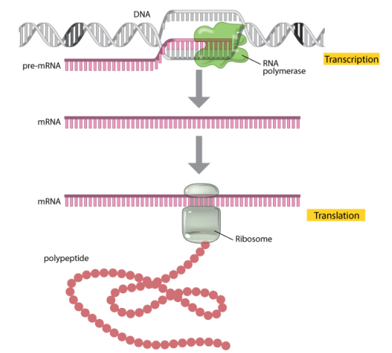
Introduction
Gene expression
Measured through RNA sequencing
Indicates the “activation status” of genes in a tissue
Widely used in medical research to understand disease mechanisms and assess the effectiveness and safety of new treatments
Image source: https://www.nature.com/

Slide 3
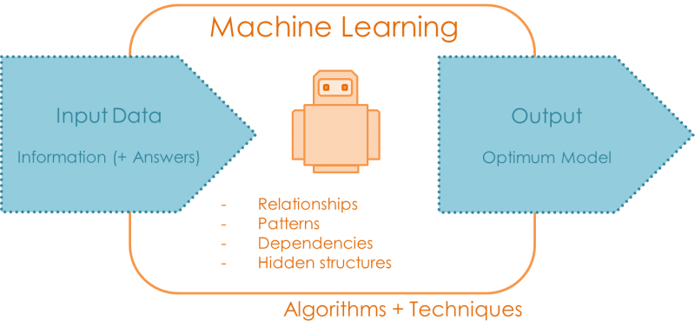
Problem
Gene expression varies across tissues
Obtaining samples from heart, lung, brain and other organs is often not possible
Goal
Image source: https://quantdare.com/
Notes:
To assess new treatments corresponding to certain tissues, need to understand the gene expression of said tissues
Goal: Development of a machine learning algorithm that can reliably predict gene expression in many different tissues when only gene expression measurements in whole blood are available

Slide 4



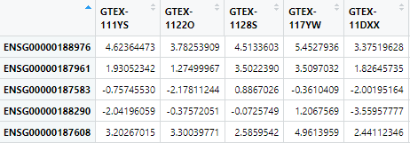
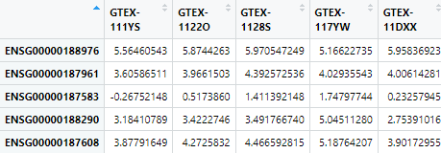

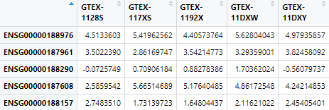
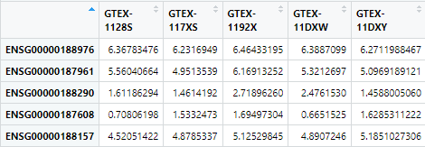
Data
Publicly available dataset (GTEx) containing gene expression of 54 post-mortem tissues from almost 1,000 individuals
Notes:
Explain: For each tissue, keep the shared genes and shared donors with blood only

Slide 5
Preliminary Data Analysis
Exploration of similarities between each tissue and whole blood
Shared genes
Shared donors
Gene expression correlation

Slide 6
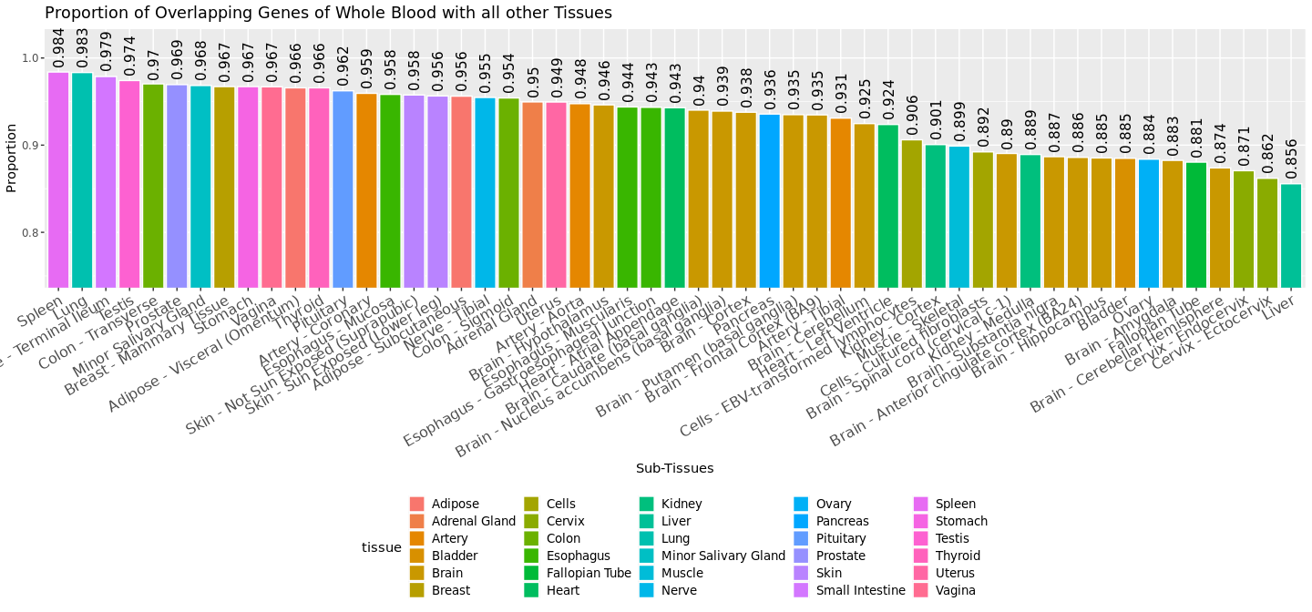
1. Shared Gene
Top 3:
Spleen
Lung
Small Intestine

Slide 7
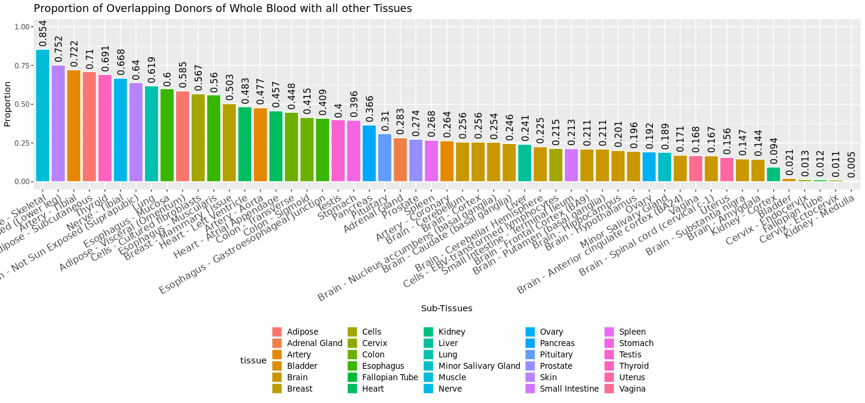
2. Shared Donor
Top 3:
Muscle – skeletal
Skin – sun exposed
Artery – Tibial

Slide 8
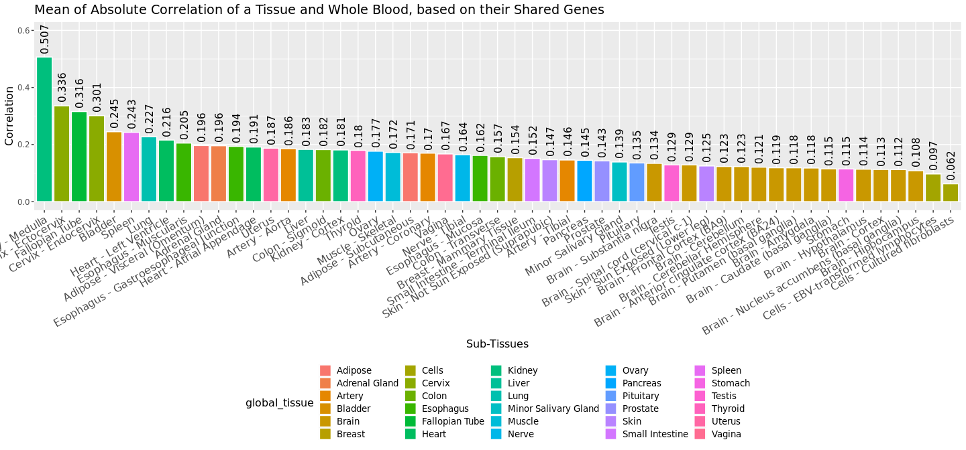
3. Correlation
Pairwise correlation between each gene in whole blood's gene expressions with the same gene in other tissues' gene expressions.
Top 3:
Kidney – Medulle
Cervix – Ectocervix
Fallopian Tube

Slide 9
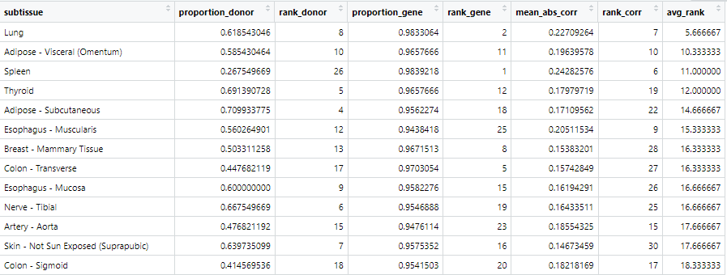
Tissue Selection
Rank tissued based on the previously observed measures
Snapshot of the ranks
Notes:
Lung has the lowest rank
Meaning: most similar to blood in terms of shared donor, shared genes and correlation
Skin-not sun exposed
Low correlation with blood
Nerve-tibial
?? Not sure why

Slide 10
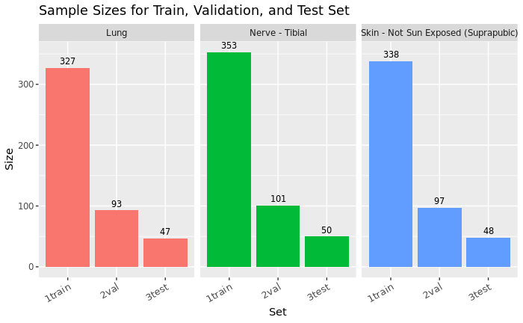
Training, Validation, and Test Set
By the method of trial and error, random sets of proportions were tried and tested on the chosen tissues
It is decided to use 70:20:10
Notes:
Explain :
train the models using training data
For hyperparameter tuning , test using validation set
Choose the best hyperparameter combination
Test using test set
for each tissue, the test set has > 30 sample

Slide 11
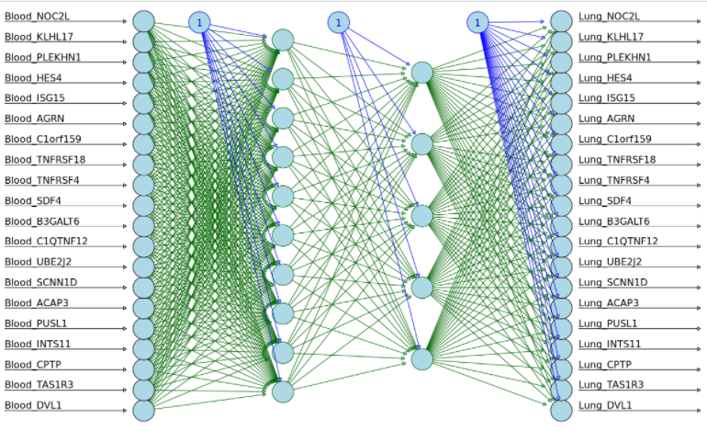
Neural Network
Illustration of how a neural network model might look
Notes:
Train : the model will be trained using the training set from both whole blood and lung
Validation / test : the model will be given the unseen validation/test set from whole blood and it will give us the prediction of the corresponding genes in lung
Parameter tuning : number of node, number of hidden layer, number of epoch

Slide 12
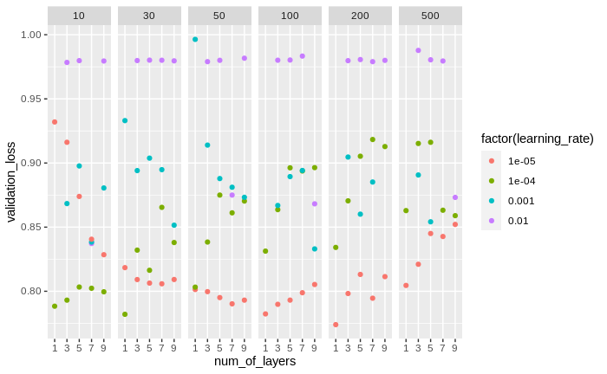
Hyperparameter Tuning
On number of layers, learning rate, and number of epochs
Notes:
Need to explain the parameters???

Slide 13
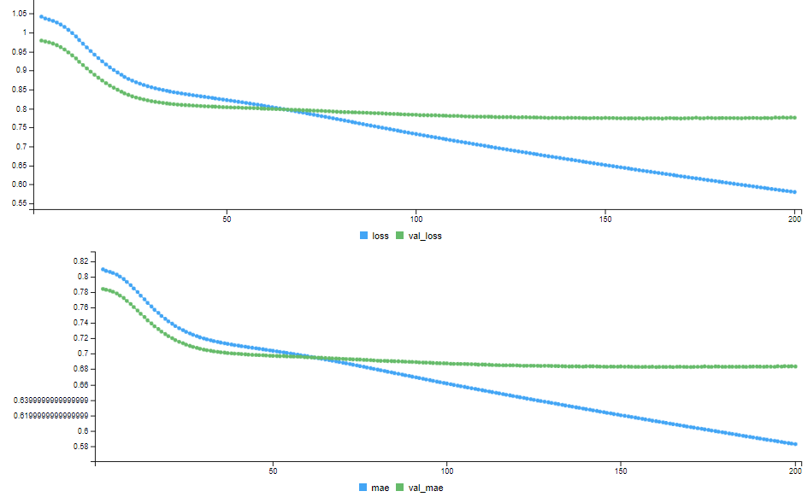
Result
Using 1 hidden layer of 100 units, e⁻⁵ learning rate, with 200 epochs

Slide 14
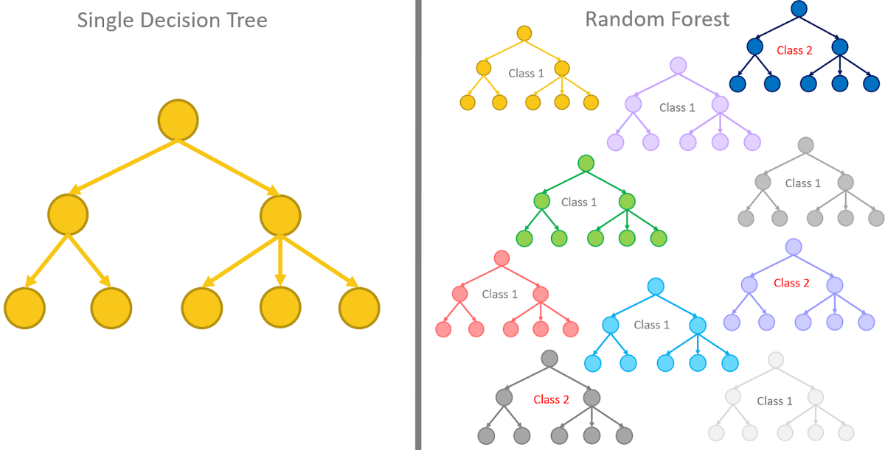
eXtreme Gradient Boosting (XGBoost)
An ensemble of decision trees
Notes:
Mention : 1 model for 1 gene bcs the model doesn’t accept multivariate output
So input: the whole gene matrix from blood
Output: 1 gene from lung

Slide 15
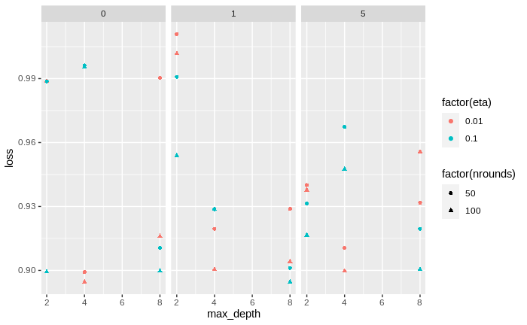
Hyperparameter Tuning
On gamma, maximum depth, eta, and number of rounds
Best hyperparameter combination: gamma=1, maximum depth=8, eta=0.1, and number of rounds=100

Slide 16
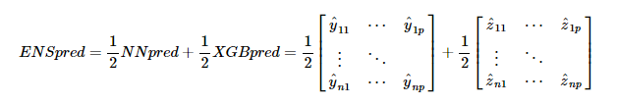
Ensemble Prediction

Slide 17
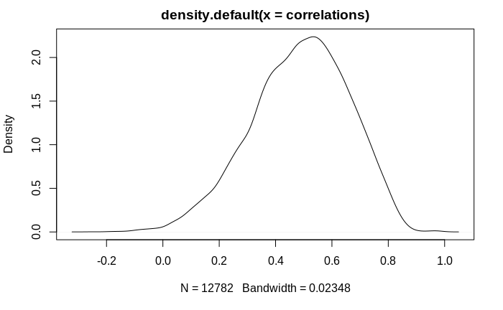
Evaluation
Compute the correlation for each gene in the prediction and the true value
Model | Correlation
Neural Network | 0.4887672
XGBoost | 0.4364047
Ensemble | 0.4976427
Notes:
Plot: density plot of the correlation from ensemble prediction
High density for positive correlation

Slide 18
Discussion
Notes:
Ensemble prediction is the best bcs it contains information from both NN and XGB

Slide 19
Future Directions
Create model and tune hyperparameter for all tissues
Use all genes from both tissues
Use another ML model for the ensemble instead of only taking the average prediction
Notes:
Mention that the previous results are only for lung

Slide 20
We would like to extend a heartfelt thank you to all our mentors involved in this project!

Slide 21
Questions?

Slide 22
Thank You

